Slide 1
Eclipse IDE and Debugging
The ‘other’ aspects of Programming
Ravikishore Kommajosyula

Slide 2
Overview
Programming is more than writing code
TODAY: The ‘other’ aspects of programming
Coding guidelines
The need for good documentation
Doxygen
Concluding Remarks

Slide 3
Coding guidelines
NEVER re-define standards
#define TRUE FALSE //Happy debugging people

Slide 4
Coding guidelines
NEVER re-define standards
Industry standard coding guidelines:
Google C++ style guide
id Software coding style
Need for standard coding guidelines:
Uniform format and look
Higher quality code and less misunderstandings
Someone else CAN look at your code
#define TRUE FALSE //Happy debugging people

Slide 5
Coding guidelines - example
Indentation: 4 spaces per level
Each code line at most 100 characters long
1 space before and after all operators and after every comma
Use UTF-8 formatting
Function names
Should be descriptive
Use a verb, or a verb followed by a noun
Use underscores (_) between words
Variable names
Same as function names
Can use underscore (_) before start..

Slide 6
Comments – Why they are important?
Use comments wisely to give reader information about what is not obvious
Should enable people to:
Re-use your code
Understand your code for maintenance and debugging

Slide 7
Comments – Why they are important?
Some useless / dangerous comments:
Don’t say what you are doing. Say why you are doing it that way
return 1; // returns 1
/** * Always returns true. */
public boolean isAvailable() {
return false;
}
const int TEN=10; // Store value of constant 10

Slide 8
Comments – Why they are important?
Some funny / yet useful comments:
// Dear maintainer:
// Once you are done trying to 'optimize' this routine,
// and have realized what a terrible mistake that was,
// please increment the following counter as a warning
// to the next guy:
// total_hours_wasted_here = 42
// somedev1 - 6/7/02 Adding temporary tracking of Login screen
// somedev2 - 5/22/07 Temporary my ###
// Magic. Do not touch
// drunk, fix later

Slide 9
Documentation Generators
A documentation generator is a tool that generates documentation for programmers or end users, from a set of specially commented source codes
Doxygen is a documentation generator for C, C++, Java, Objective-C, Python and to some extent PHP, C# and D
Portable (Windows/ Linux/ Mac)

Slide 10
Doxygen
Doxygen is very useful for creating useful documentation for large projects without additional effort (except the special format commenting)
Eclipse has plugins that helps in creating Doxygen compliant comments
Not too much additional work to create Doxygen compliant comments

Slide 11
Doxygen – How to use
The entire process at a glance
Configuration File
Comment the Source Code
Run Doxygen
doxygen –g <filename>
Create the configuration file for the project
Special Doxygen compliant comments
Starts with /** (or) /// (or) /*!
doxygen <configfile>
Creates the documentation in specified format (html, pdf, latex)

Slide 12
Doxygen
Well documented, you just need to fill in the blanks (GUI also available)
Main things to set:
PROJECT_NAME = Adv_Prog
OUTPUT_DIRECTORY = ./doc
INPUT = ./src ./include
FILE_PATTERNS = *.cpp *.hpp
GENERATE_HTML = YES
EXTRACT_ALL = YES

Slide 13
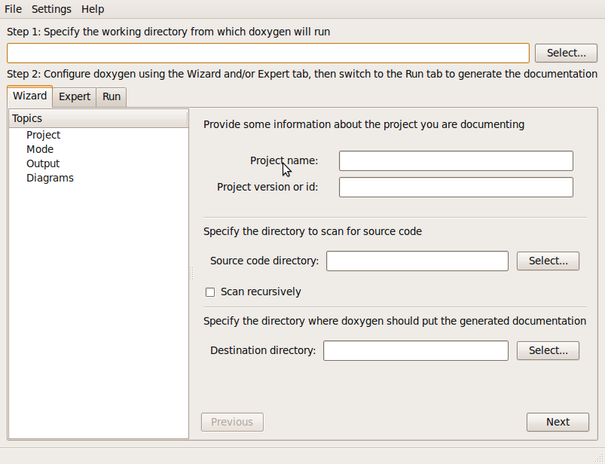
Doxygen - GUI

Slide 14
Doxygen
Beginning of file:
/*! \file dpoint.hpp
\brief d-dimensional point class
A d-dimensional point class which is written carefully
using templates. It allows for basic operations on points
in any dimension. Orientation tests for 2 and 3 dimensional
points are supported using
<a href="http://www.cs.berkeley.edu/~jrs/">Jonathan's</a>
code. This class forms the building block of other classes
like dplane, dsphere etc.
\author <a href="www.compgeom.com/~piyush">Piyush Kumar</a>
\bug No known bugs.
*/
Start of file
Brief description
Detailed Description
HTML allowed
Author
Bugs

Slide 15
Doxygen
Beginning of function:
/*! \brief Prints character ch at the current location
* of the cursor.
* If the character is a newline ('\n'), the cursor should
* be moved to the next line (scrolling if necessary). If
* the character is a carriage return ('\r'), the cursor
* should be immediately reset to the beginning of the current
* line, causing any future output to overwrite any existing
* output on the line. If backsapce ('\b') is encountered, …
\param ch the character to print
* \return The input character */
int putbyte( char ch );
Brief description
Detailed Description
Parameter
Return

Slide 16
Doxygen
Create a main page using @mainpage
Each file/function should have a header block
Use meaningful names for variables, constants and functions (They come up in the documentation with @params)
To document a class function, you first have to document the class (Hierarchy)
Doxygen plugins makes your life easy

Slide 17
Doxygen - Demo
Demo on how to generate documentation using Doxygen for a C++ project with Eclipse
Reference to Doxygen Documentation (generated using Doxygen) - http://www.stack.nl/~dimitri/doxygen/manual/docblocks.html

